Slide 1

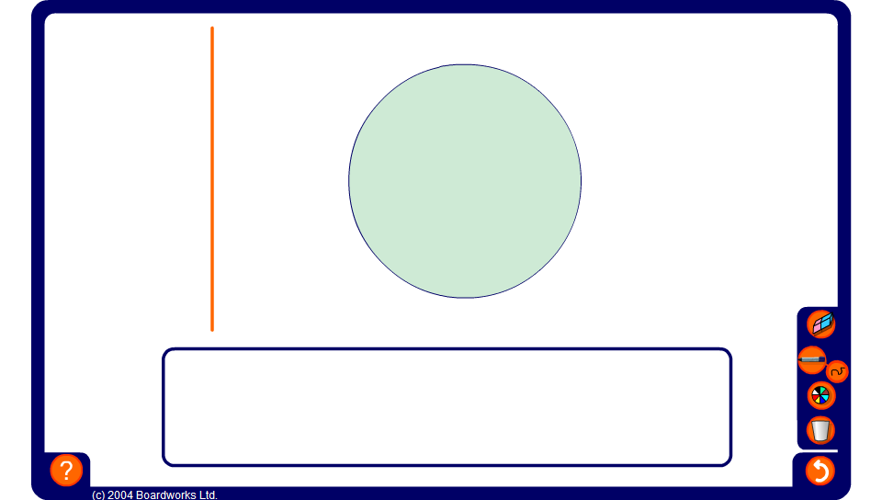


A line moving through a circle
Notes:
Drag the line through the circle to define the tangent, chords, and segments.

